Slide 1
Dabas tūrisms visiem (Introducing Nature Tourism for all- UNIGREEN)
Nr.LLI-010
Project Management meeting
25.10.-26.10.2018. in Biržai
Saldus

Slide 2
Project activities
1.Watching tower building near of Sātiņu ponds.
2. Visitor counter installation in a bird watching tower. Counter has installed.
3.Project publicity activities.

Slide 3
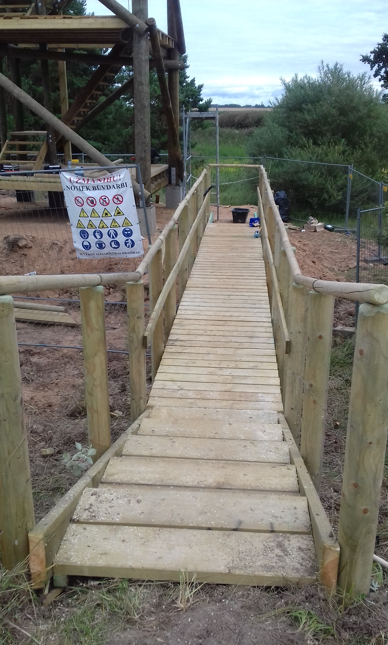
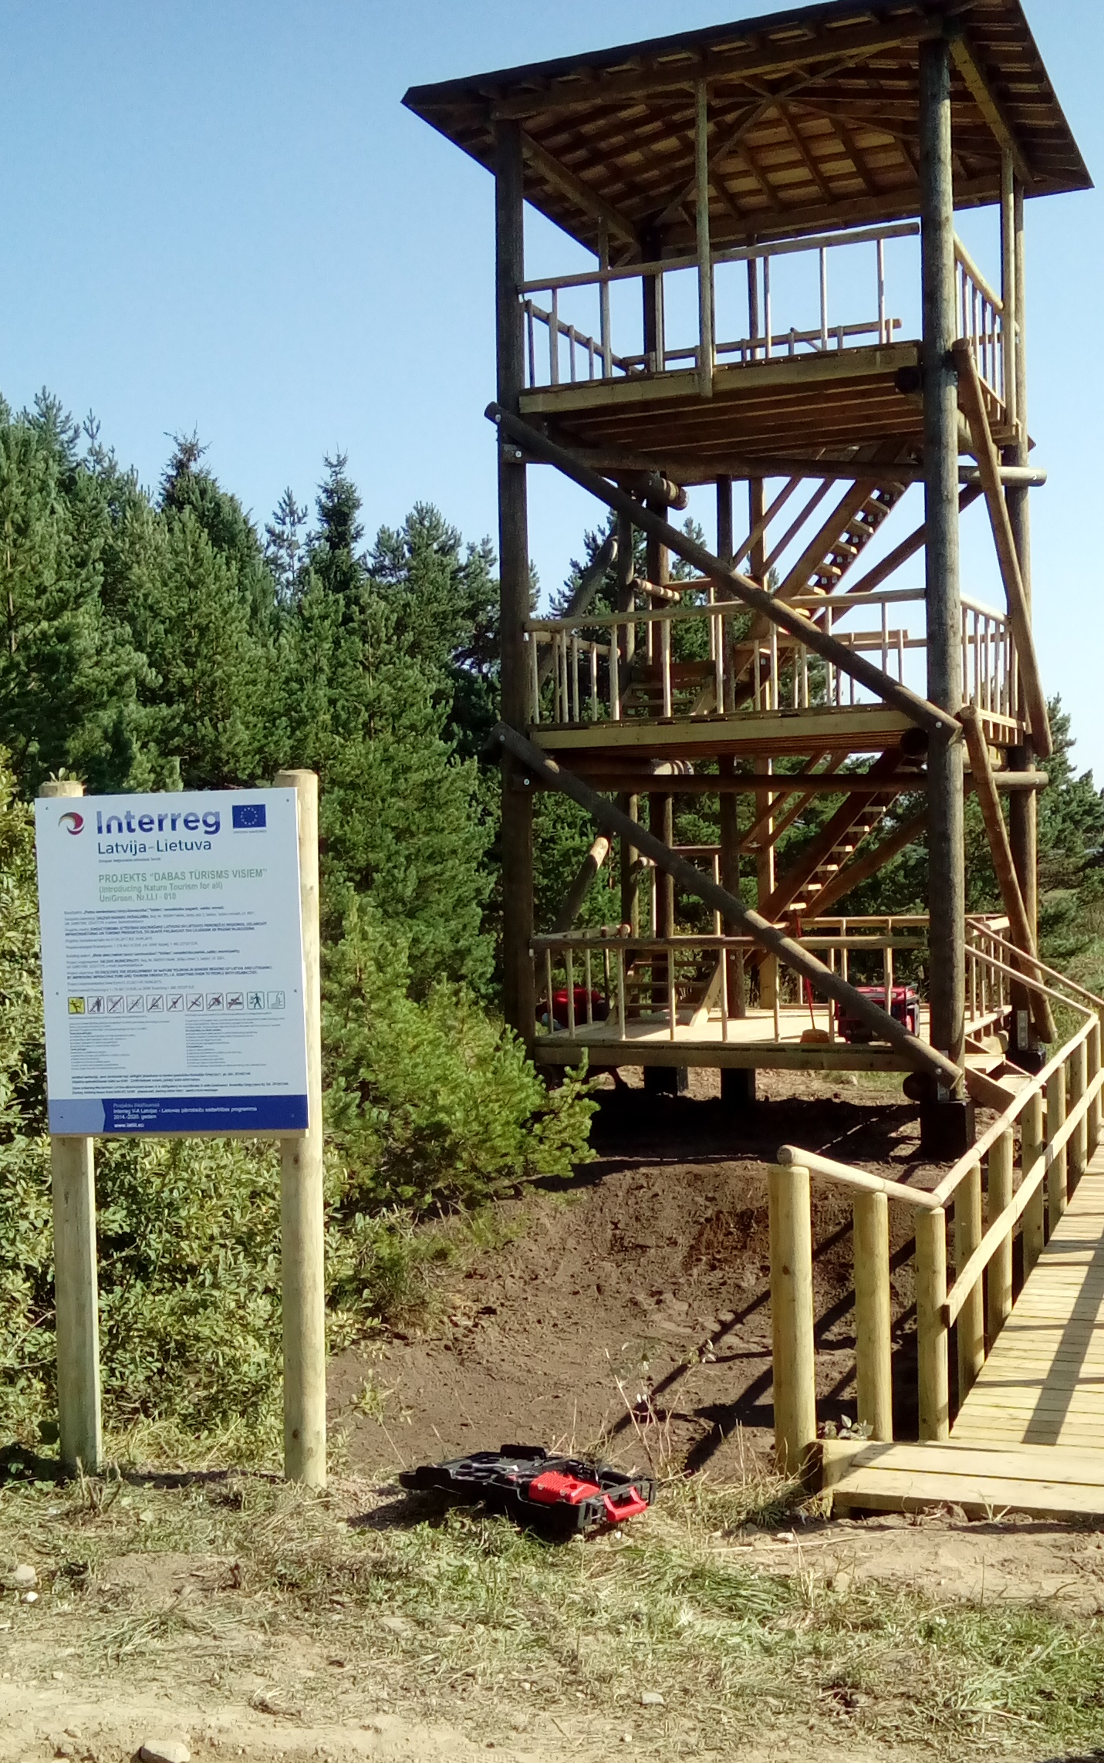
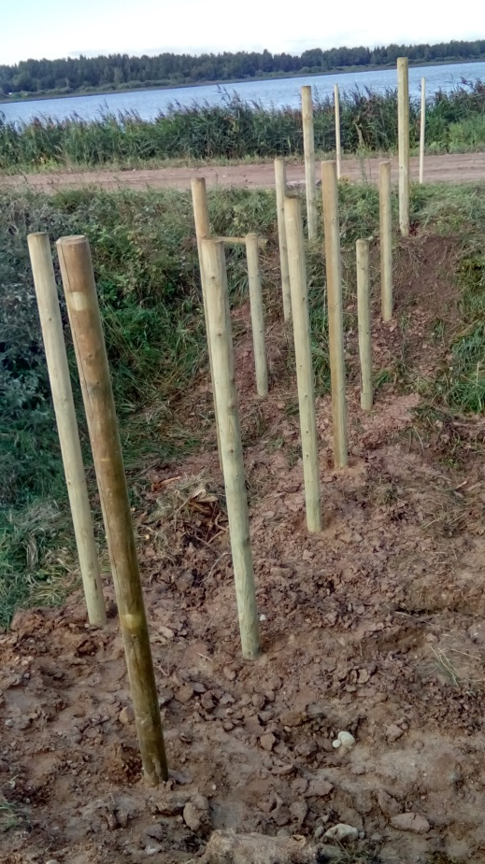
Some photos in process of construction works

Slide 4
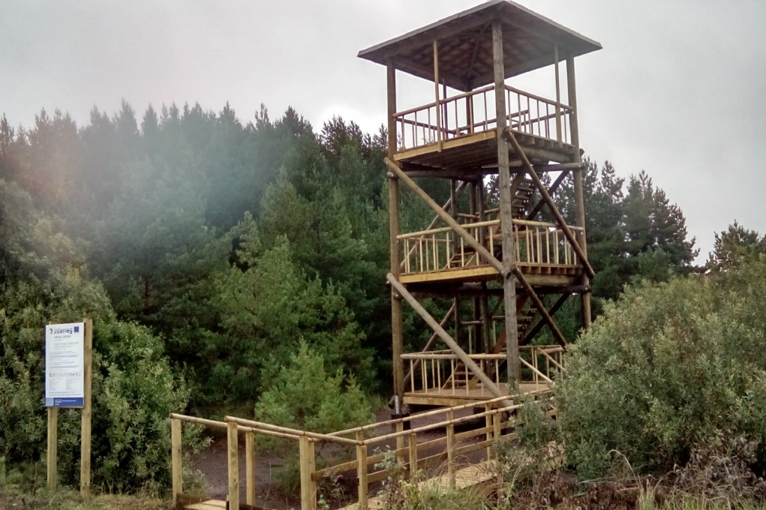
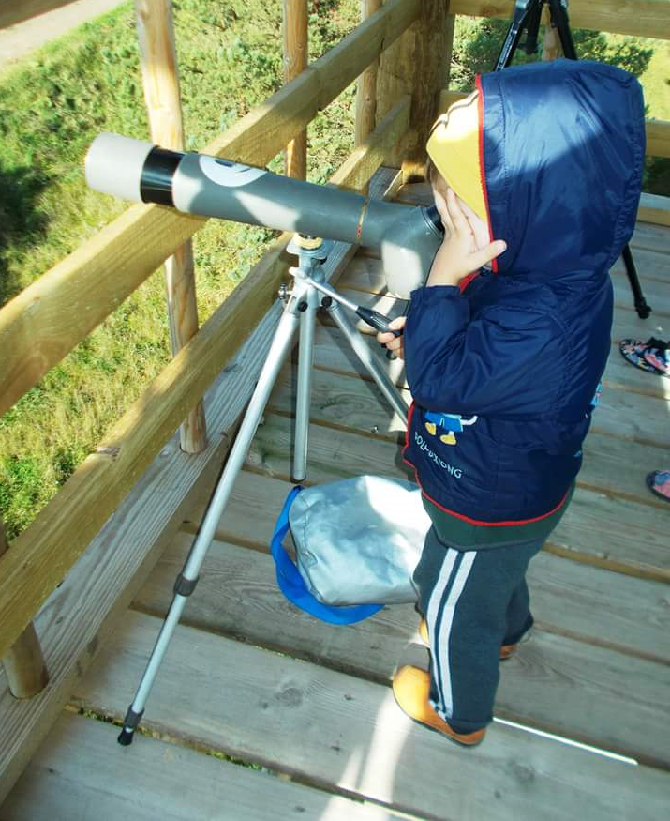
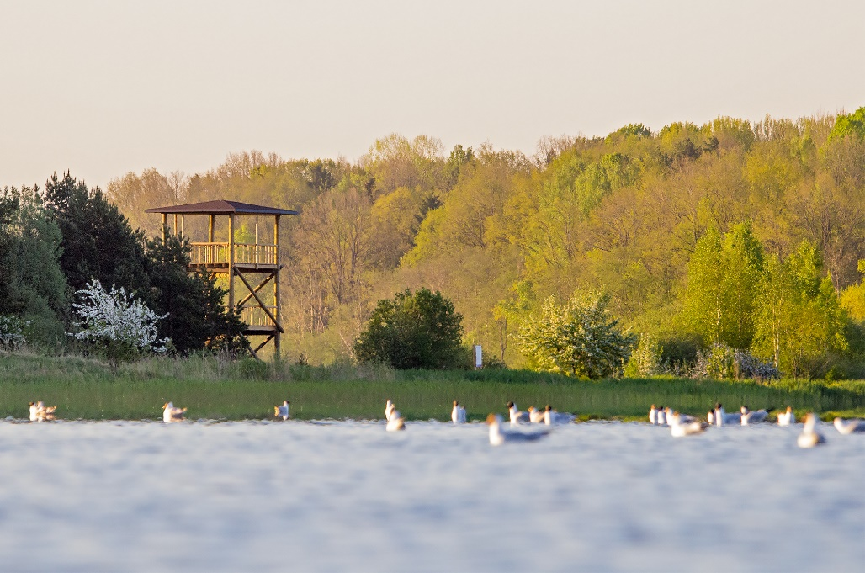
After…

Slide 5
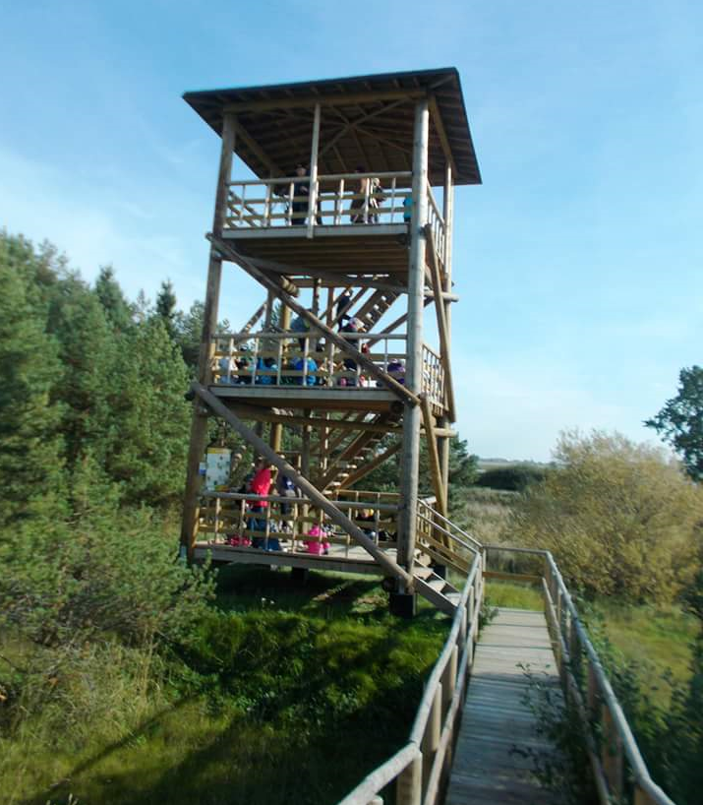
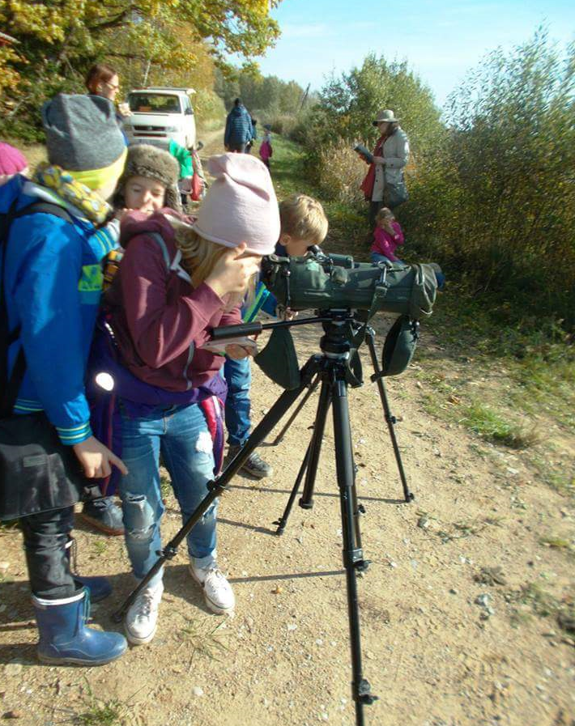
After…

Slide 6
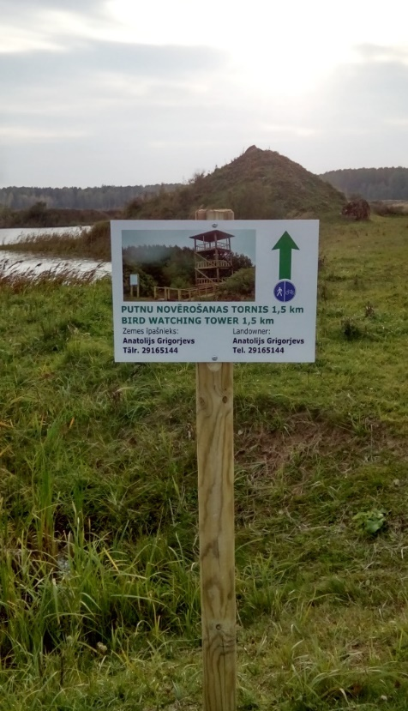
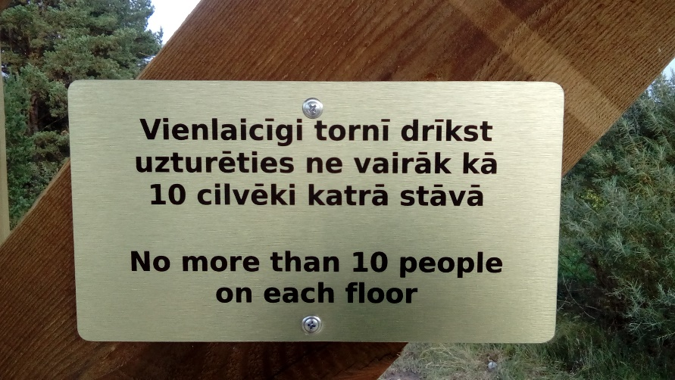
Project publicity
At the tower installed stand with informations about project, order rules and Warning signs.

Slide 7
Stand in the Tower

Slide 8
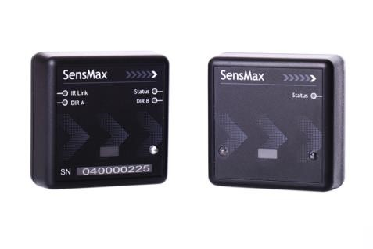
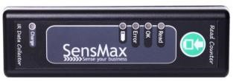
Visitor counter consists of:
Data sensors
Manual Data reader
SensMax SE
SensMax SE/DE
Infrared technology.
The equipment is in the protective housing
The set consists of two blocks, one of which is a transmitter, and the other is a receiver.
Sensors can store data up to 250 days.
Manual data collector for data collection from Sensors.
Report program who installed on computer

Slide 9
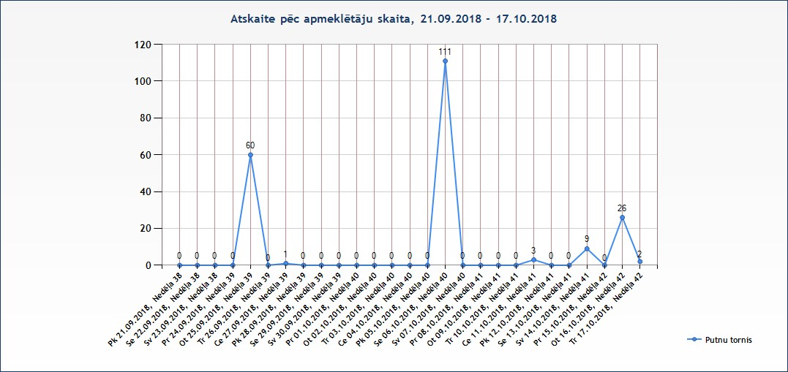
Visitor Counter

Slide 10
Project budget
Period |  | Planning | Actual
1. | Report Nr.1 | € 43 520,85 | € 20 979,67
2. | Report Nr.2 | 0 | € 7 404,69
3. | Report Nr.3 | € 300,16 | € 1562,50 | Tourist counter 1396,50 Management 116 +50 =166
4. | Reports Nr.4 | € 287,26 | 0
 | Total | € 44108,27 | € 29 946,86 | Now Save 14 161,41

Slide 11
Thank you for attention!
Eva Jēkobsone
eva.jekobsone@saldus.lv
+371 20267729

