Slide 1
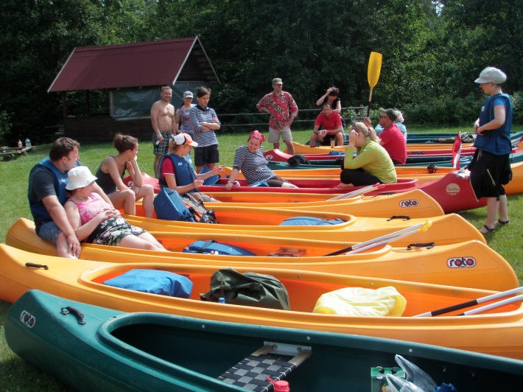
Project activities in Kurzeme region
Kick-off Meeting 17.04.2013, Sigulda, Latvia

Slide 2
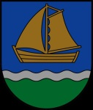
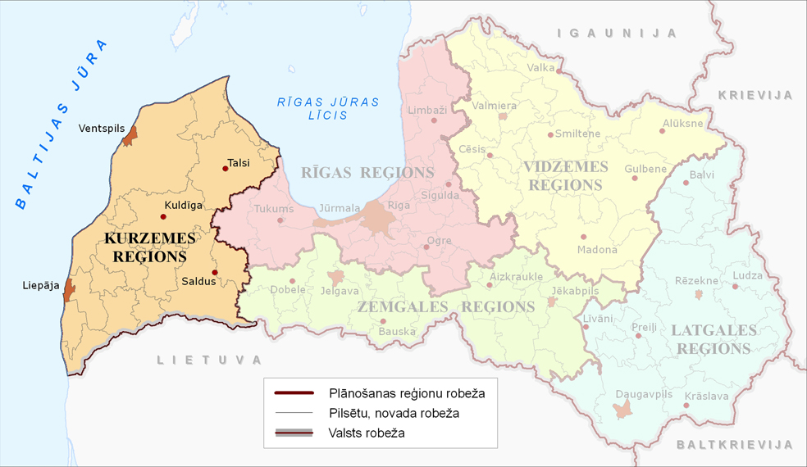
Kurzeme - region in West Latvia:
18 districts –
Alsunga, Kuldīga, Skrunda, Grobiņas Rucava, Nīca, Priekule, Vaiņode, Durbe, Pāvilosta, Aizpute, Saldus, Brocēni, Dundaga, Talsi, Roja, Mērsrags and Ventspils districts
2 big cities – Liepāja and Ventspils

Slide 3
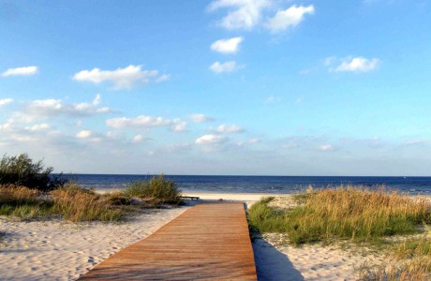
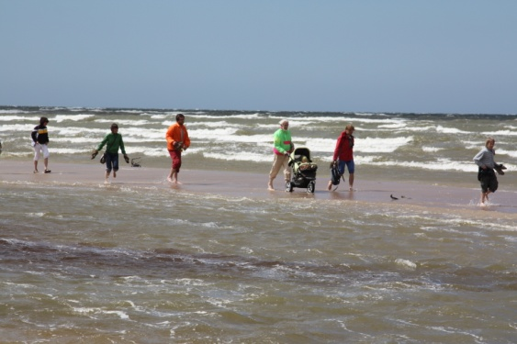
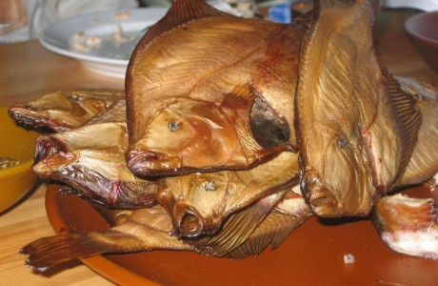
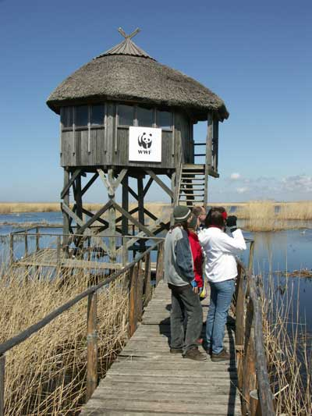
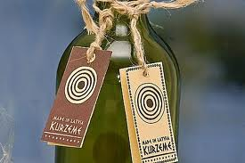
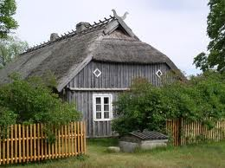
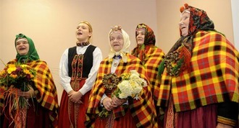
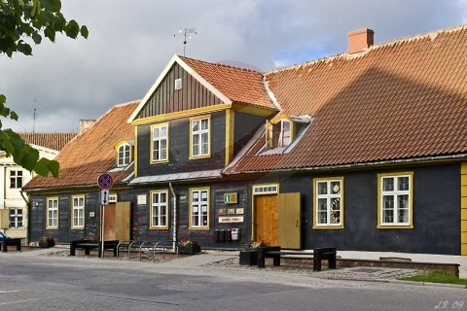
Kurzeme region values and characteristics
More than 350 km long Baltic sea coast – white sandy beaches – summer holidays destinations;
Nature protected areas (Natura 2000) – Slītere National park , 11 nature parks and picturesque landscapes serve as resources for nature and active tourism products
Cultural heritage and traditions – fishing villages, small historical towns, culture, sport and leisure events;
«Made in Kurzeme» - joint brand for traditional products and articles, produced in Kurzeme

Slide 4
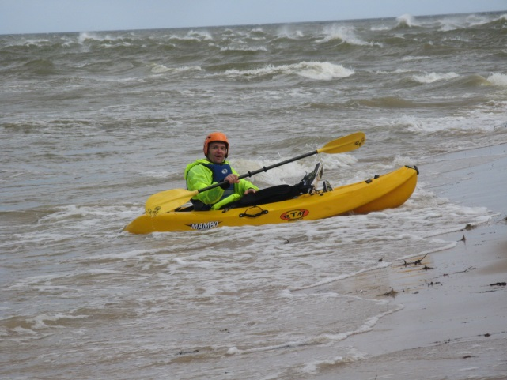
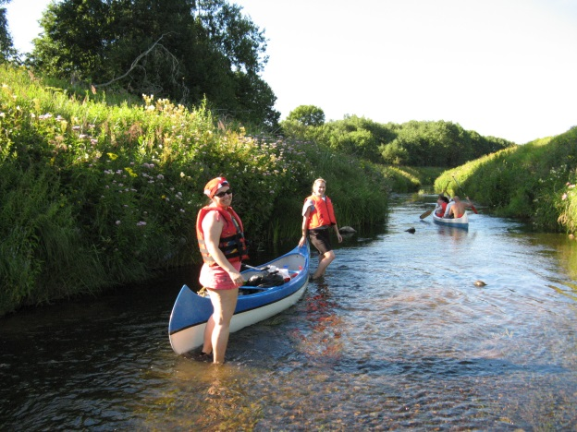
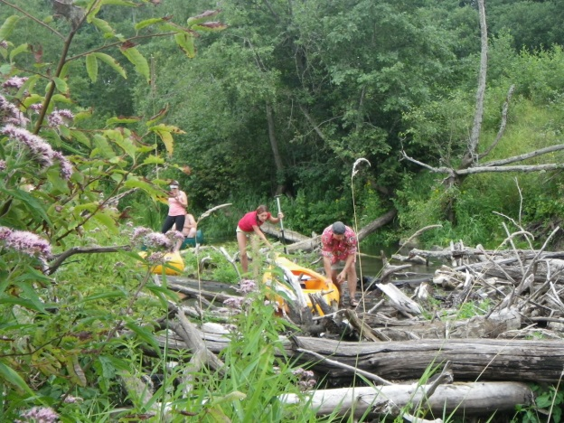
Project in Kurzeme...
9 rivers involved in the infrustructure activities – cleaning, resting areas, information stands, signs, access road improvements
In cooperation with canoe companies – to identify and develop at least 5 new active tourism products
To encouarge sea kayaking routes around Kurzeme coastline areas;
To bring together canoe companies, local tourism service providers (guest houses, local product producers, tourism sites etc.) and municipalities to plan and manage each river used for canoing actively;
To promote not only so far very popular rivers for canoing, but also to attract tourists to less known, but still very friendly and interesting rivers all over Kurzeme;
To enourage people to enjoy nature and active holiday not only in a few weekends in summer....

Slide 5
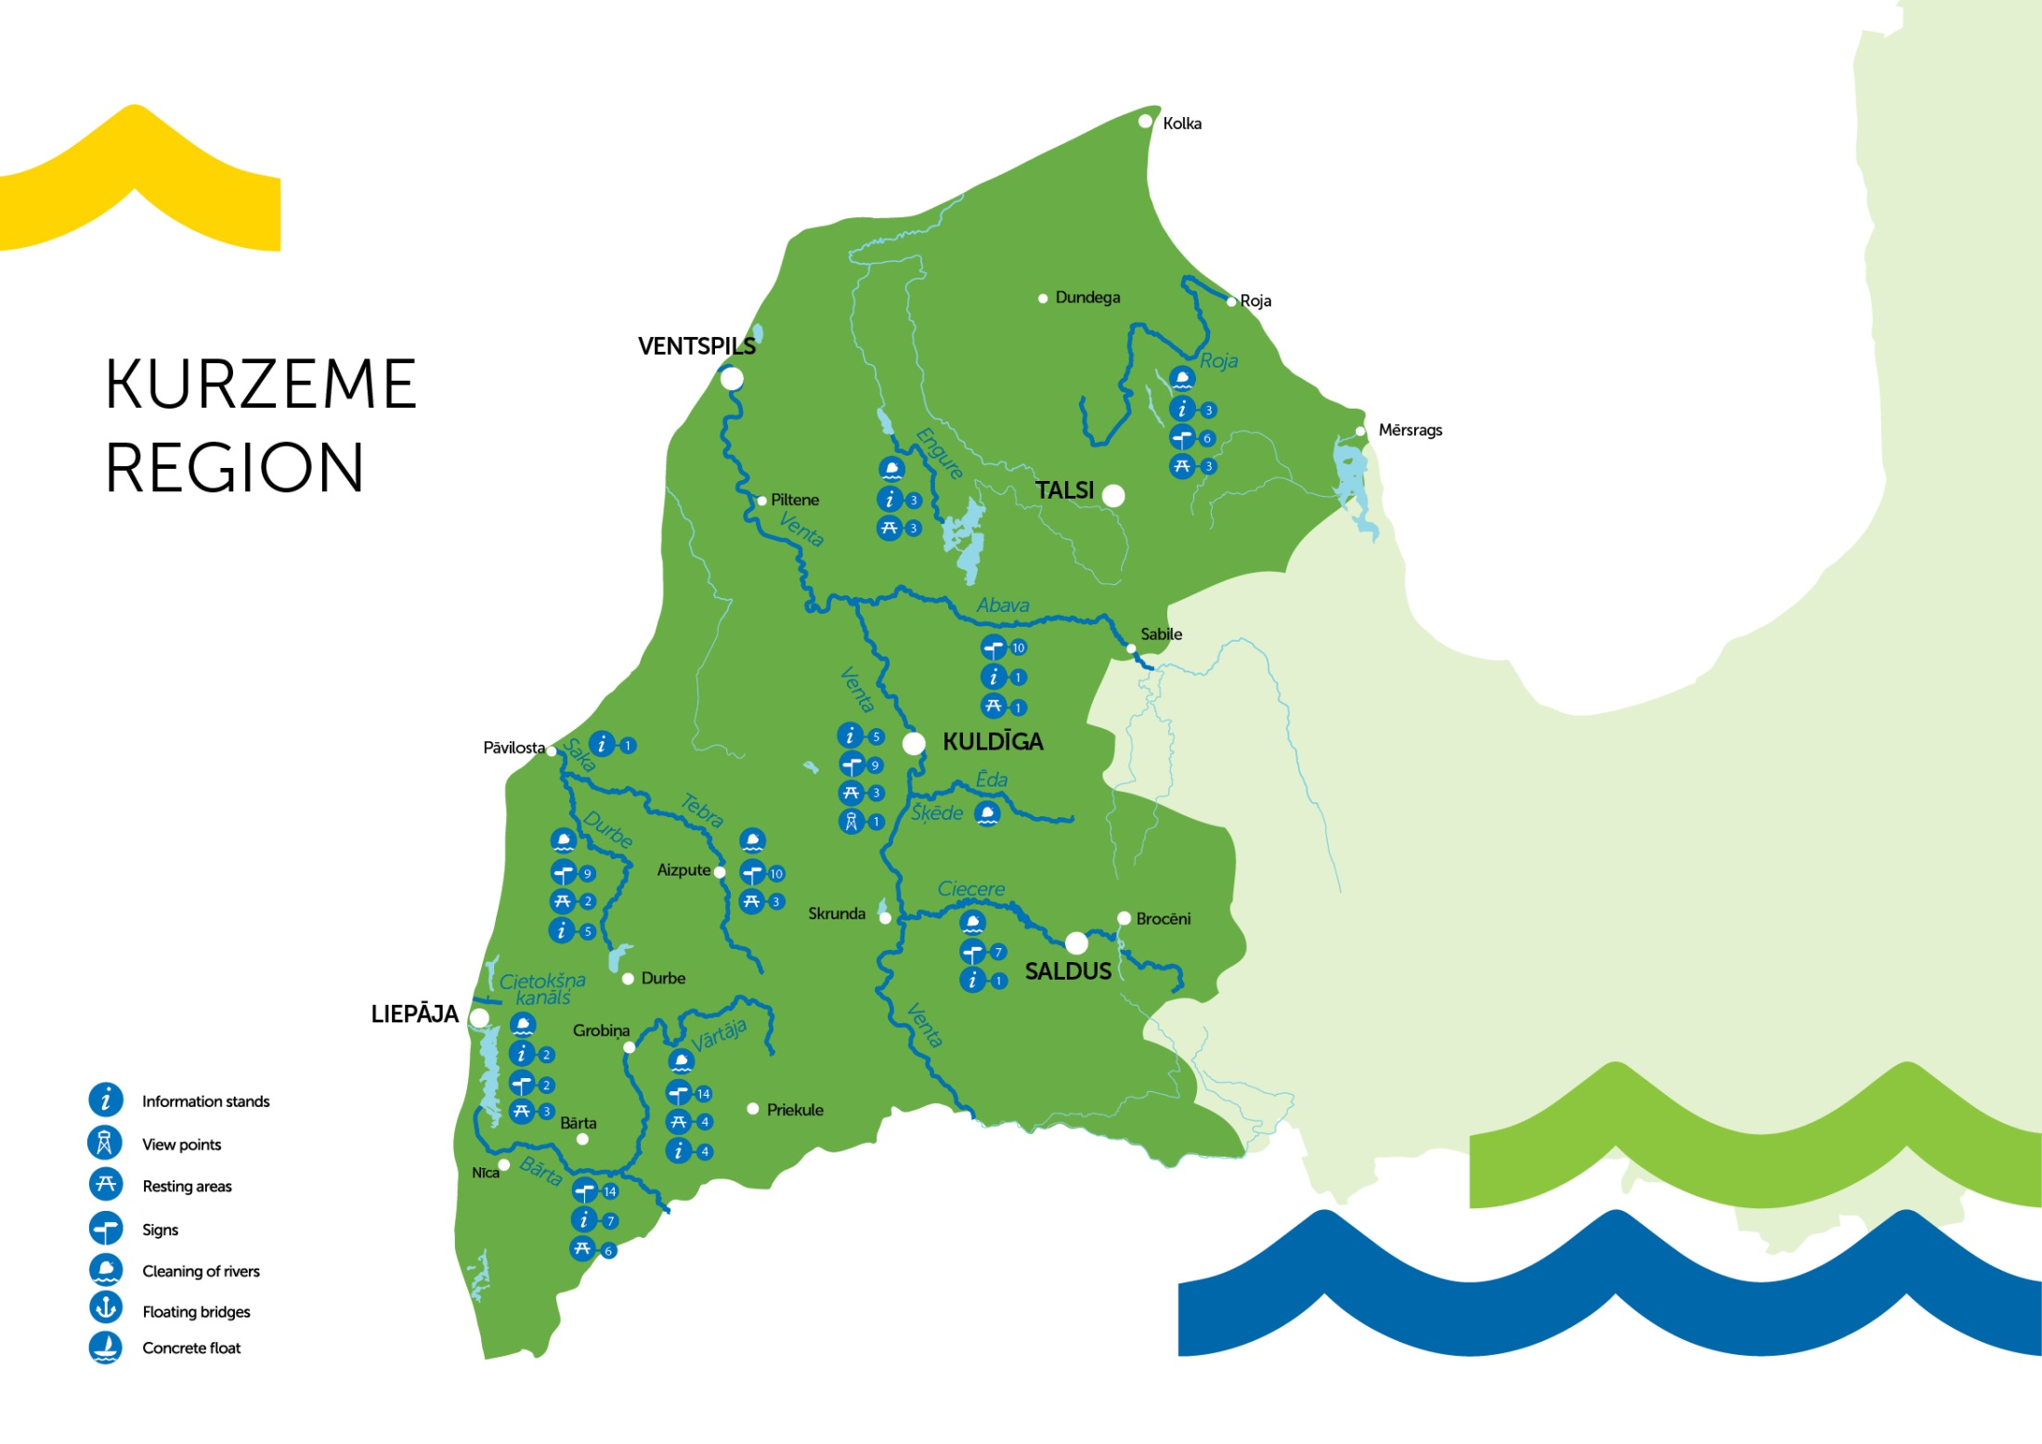
Map of project activities
9 rivers Cleaned
32 Information stands
81 signs
28 resting areas
1 viewpoint
5 access road section

Slide 6
Aiga Petkēvica
Kurzeme Planning region
Project manager
Phone +371 67338738; +371 29483674
Skype: aiga_petkevica
e-pasts: aiga.petkevica@kurzemesregions.lv
Welcome to Kurzeme!

