Slide 1




Contaminated sites database development in INSURE
Intars cakars
12.09.2019

Slide 2
Contaminated sites data in Latvia
information was collected in years 2003-2005;
first contaminated and potenntially contaminated sites data base was created;
for information collection SIA «Vides Projekti» was contracted;
since that time information update was very poor;
lot of changes in real situation.

Slide 3
Latvia data base I
Reasons to create a new one:
- Old and not updated information;
Technically need for improvement;
Personal data protection EU regulations;
Old classification was in use (NACE and territory)
https://www.meteo.lv/lapas/vide/piesarnoto-un-potenciali-piesarnoto-vietu-registrs/piesarnoto-un-potenciali-piesarnoto-vietu-registrs?id=1527&nid=373

Slide 4
Latvia data base II
Main improvements:
Electronical data flow;
Possibility add information about researches and remediation works;
Information about type;
Add attachments;
Connection with land cadastre data;
Part of Joint Environment Information system (JEIS) (Maintained by LEGMC).

Slide 5
Latvia data base III
Development and implementation steps:
Interviews with stakeholders (Municipalities, Regional Environmental boards);
Study visits to Finland, Sweden;
Review materials from other countries;
Preparation of data base new form;
Specification for procurements procedure;
Procurement procedure;
Decision about winners, contract preparation;
Implementation phase. All work was divided in 2 weeks milestones. After each milestone we had meeting and test of deliverables;
Acceptance tests. Payments;
Data base is public since May 2018;
Support from producers in scope JEIS.

Slide 6
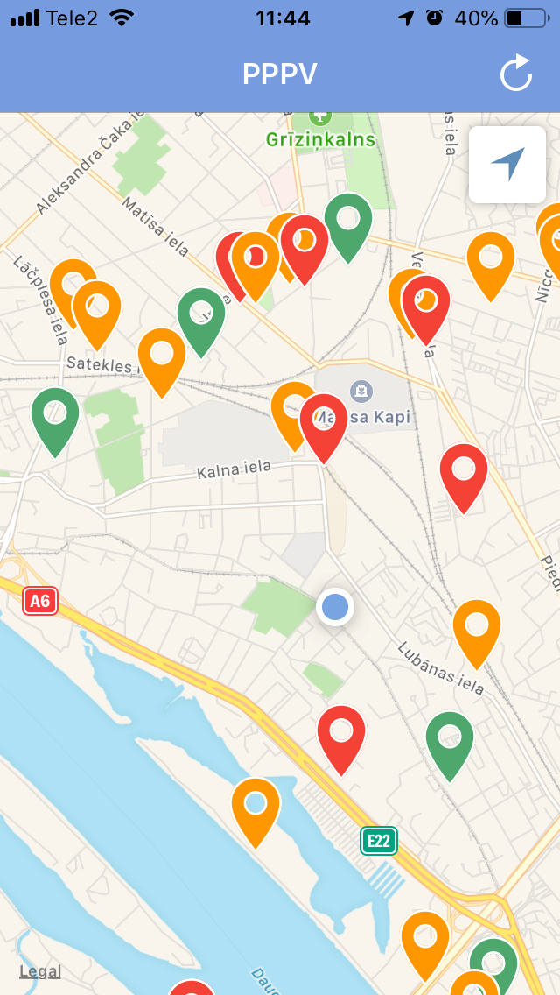
Mobile aplications
2 applications types – iOS and Android
Possibility to find Contaminated Site with mobile phone if GPS is available
Applications download from LEGMC website - https://www.meteo.lv/lapas/vide/piesarnoto-un-potenciali-piesarnoto-vietu-registrs/piesarnoto-un-potenciali-piesarnoto-vietu-registrs?id=1527&nid=373

Slide 7
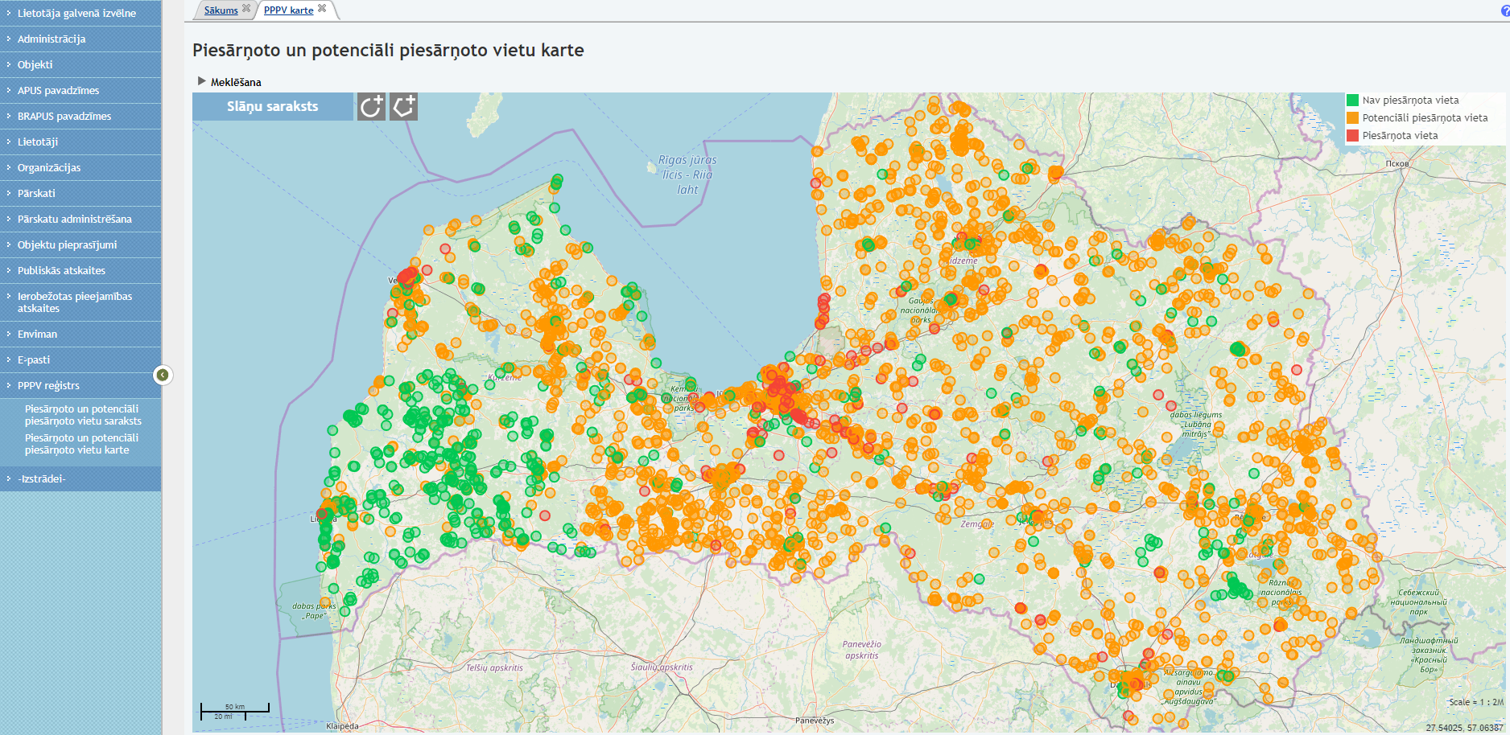
Map

Slide 8
Thank You !!!
Intars.Cakars@lvgmc.lv

